Slide 1


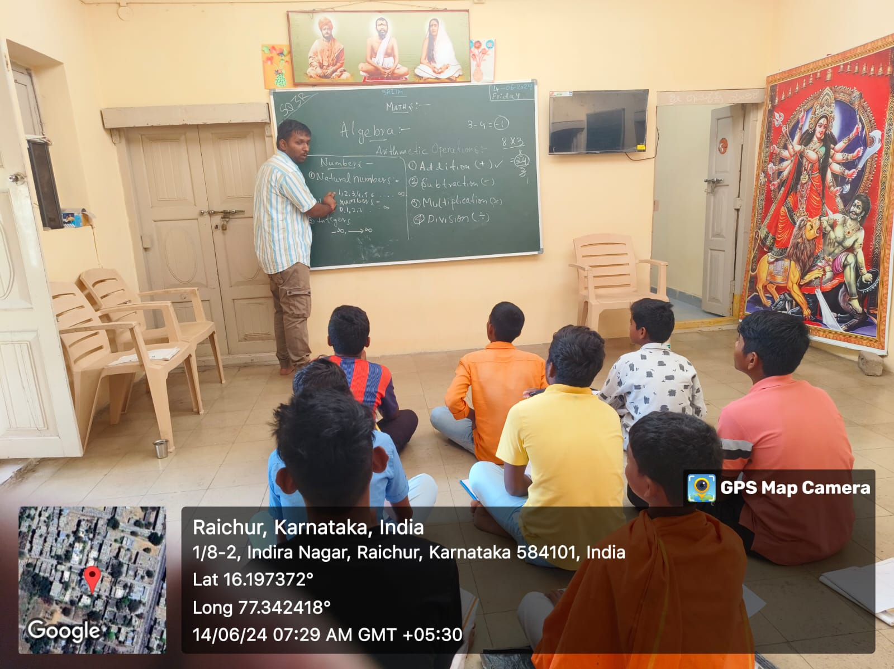
Community Development Project (GEN231)
Child Rights and Education
Veeresh A
12319252

Slide 2
Project: Child Rights and Education Objective: Promote awareness about child rights and enhance education for underprivileged children Location: Raichur region Focus: Structured educational support and rights awareness Under:-P. Venugopal 9535532932

Slide 3
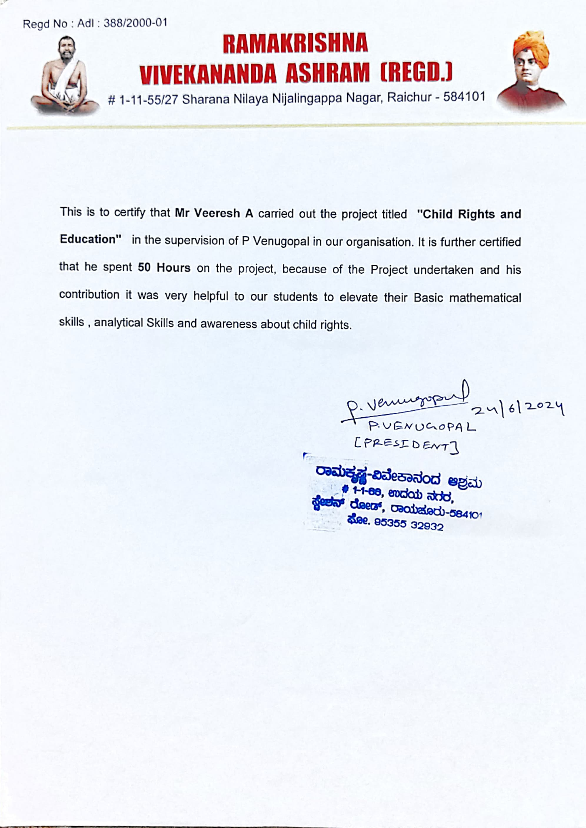

Slide 4
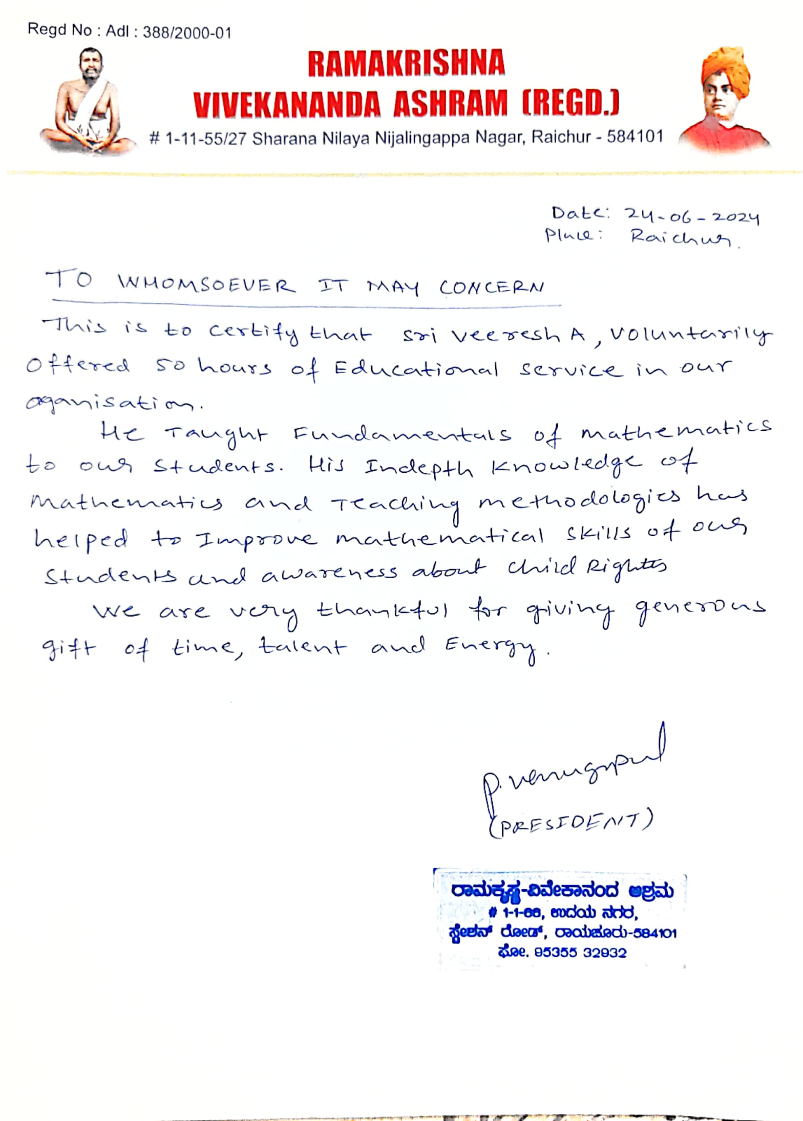

Slide 5
Problem Identification Issues: 1.Gap in access to quality education. 2.Economic and social struggles. 3.Lack of awareness regarding child rights. Impact: 1.Low literacy rates. 2.Limited knowledge and opportunities. 3.Perpetuation of poverty and social inequality.

Slide 6
Objectives Core Objective: Provide quality education and raise awareness about child rights Focus Areas: 1.Fundamental mathematical concepts 2.Rights awareness Goals: 1.Strengthen academic skills 2.Create a supportive environment for personal and intellectual growth

Slide 7
Steps taken a. Identifying the Target Group Collaboration with local schools, leaders, and social workers b. Curriculum Development Focus on algebra, BODMAS, LCM, HCF, principle of interest, squares and square roots, cubes and cube roots. c. Establishing Learning Spaces Child friendly environments with necessary educational materials.

Slide 8
d. Awareness Campaigns Educating the community about child rights and the importance of education. e. Volunteer Engagement and Training Training sessions for effective teaching and classroom management. f. Conducting Tutoring Sessions Regular, interactive, and engaging after-school sessions.

Slide 9
g. Monitoring and Evaluation Pre- and post-assessments. Feedback sessions. Geo-tagged pictures for documentation. h. Collection of Testimonials and Feedback Positive feedback from children, parents, and community

Slide 10
Effectiveness Achievements: Significant improvement in understanding of mathematical concepts. Enhanced academic skills and interest in learning. Increased community support for child rights and education. Empowerment: Better understanding of rights and importance of education. Safe and conducive learning environments. Visual records of project impact with geo-tagged pictures.

Slide 12
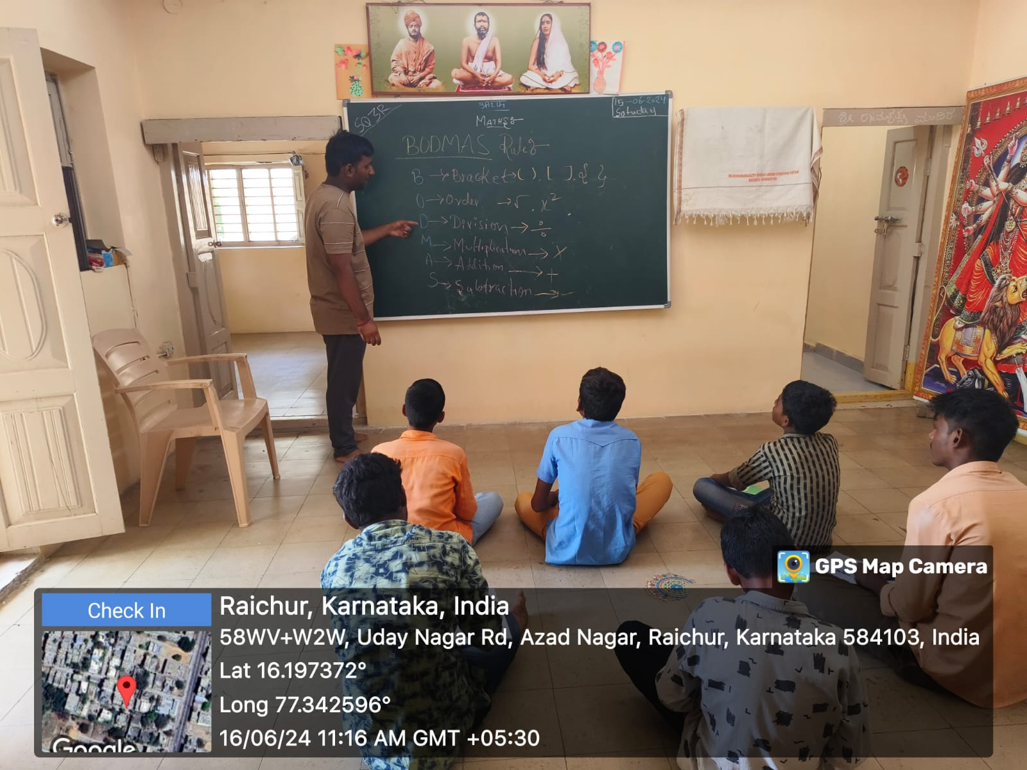

Slide 13
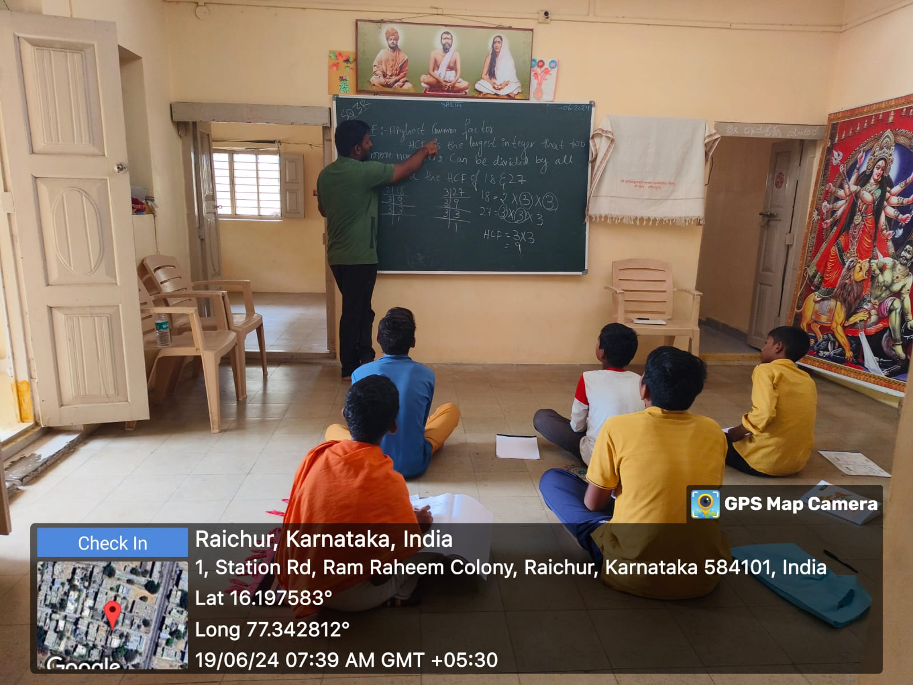

Slide 14
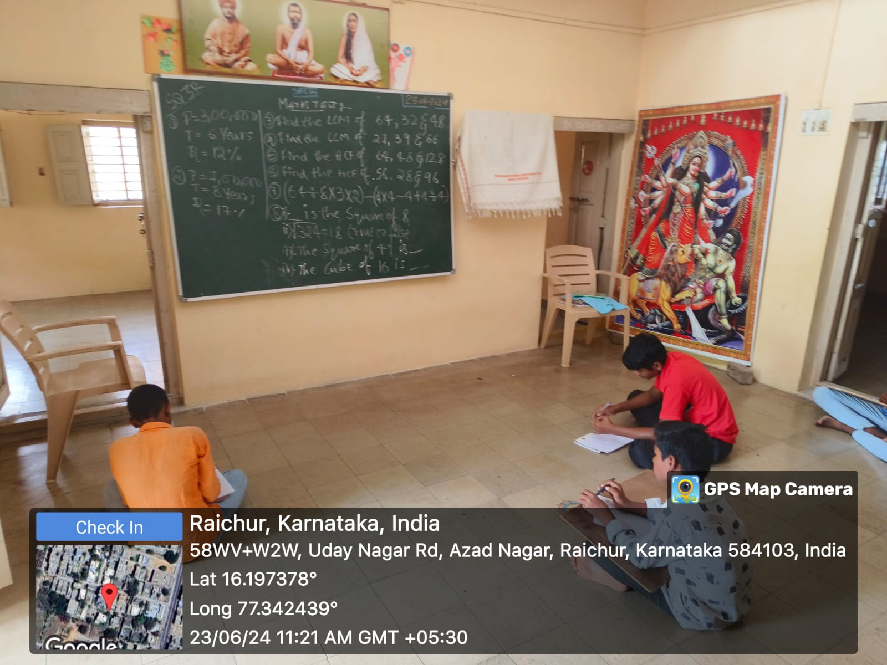

Slide 15
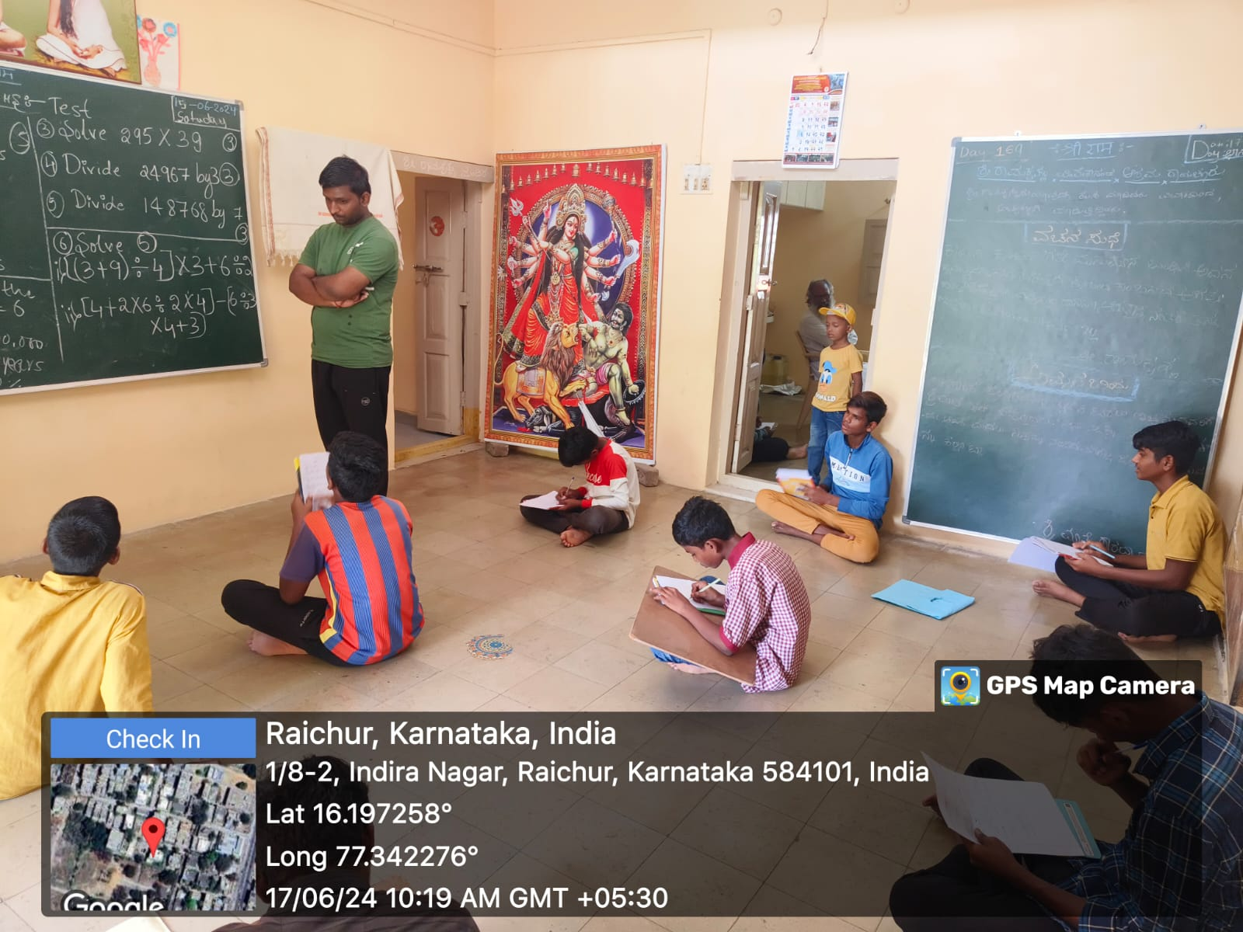

Slide 16
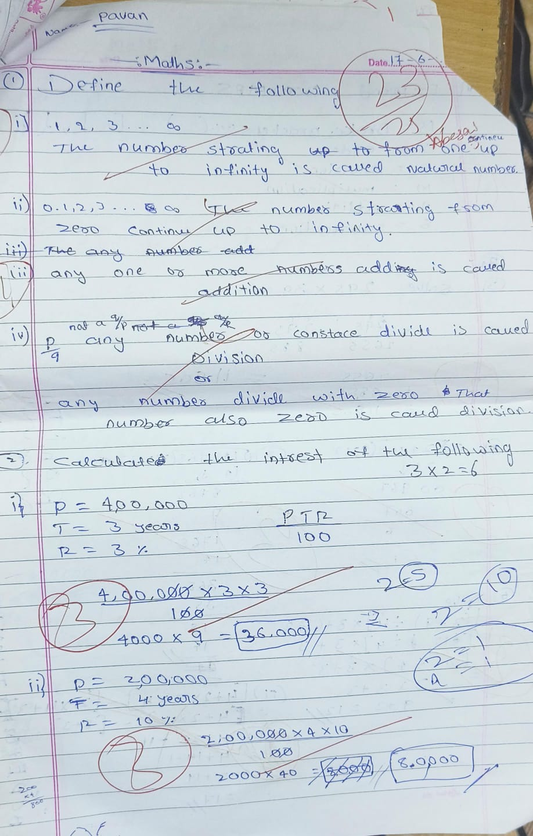
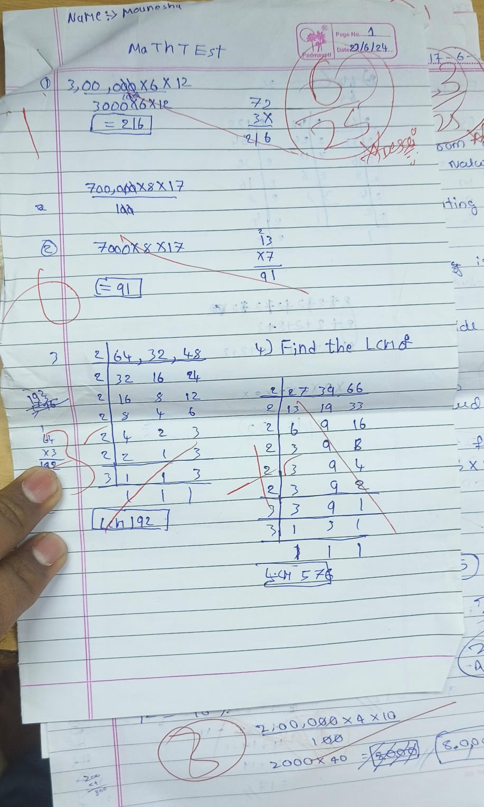

Slide 17
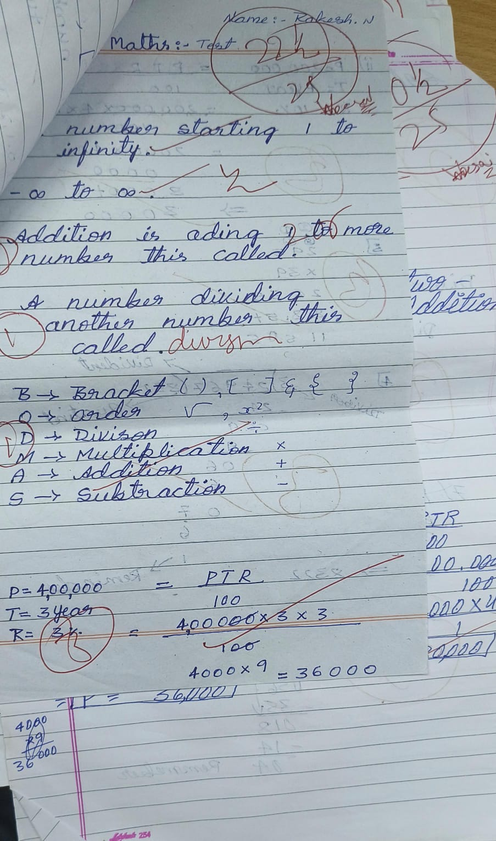
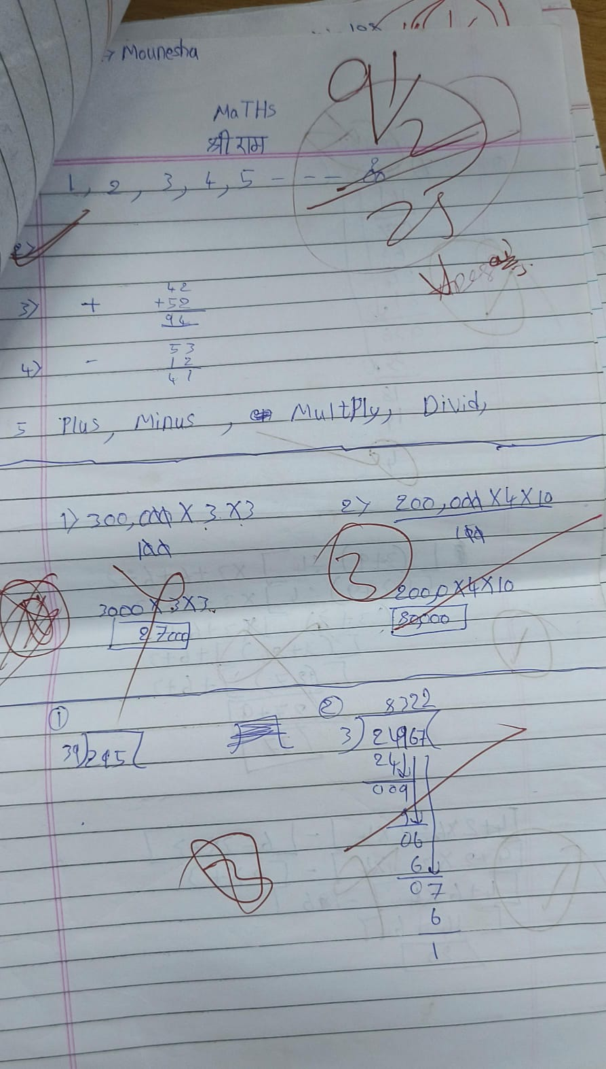

Slide 18
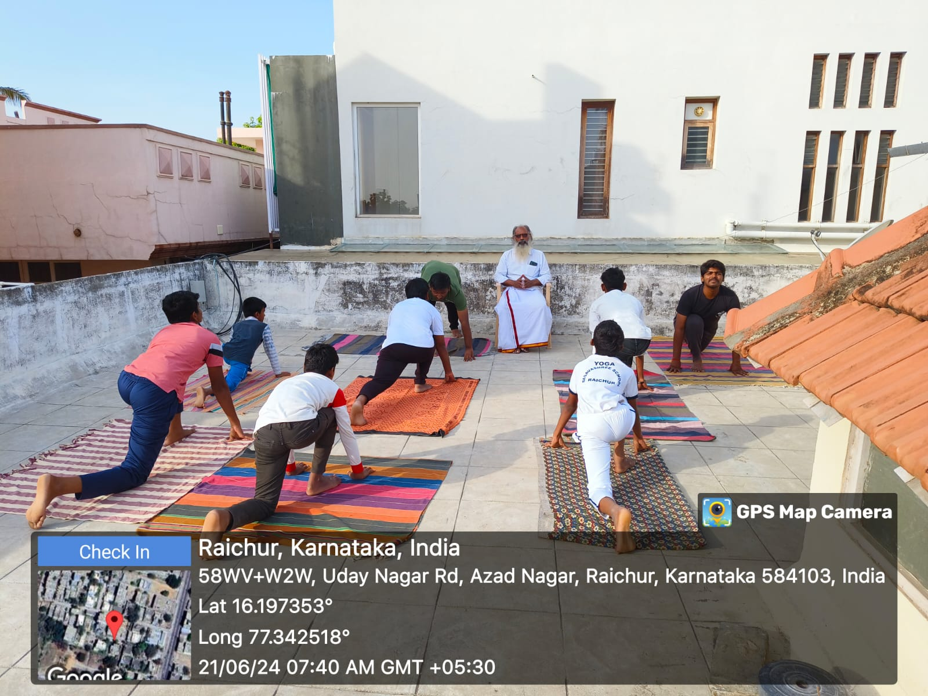

Slide 19
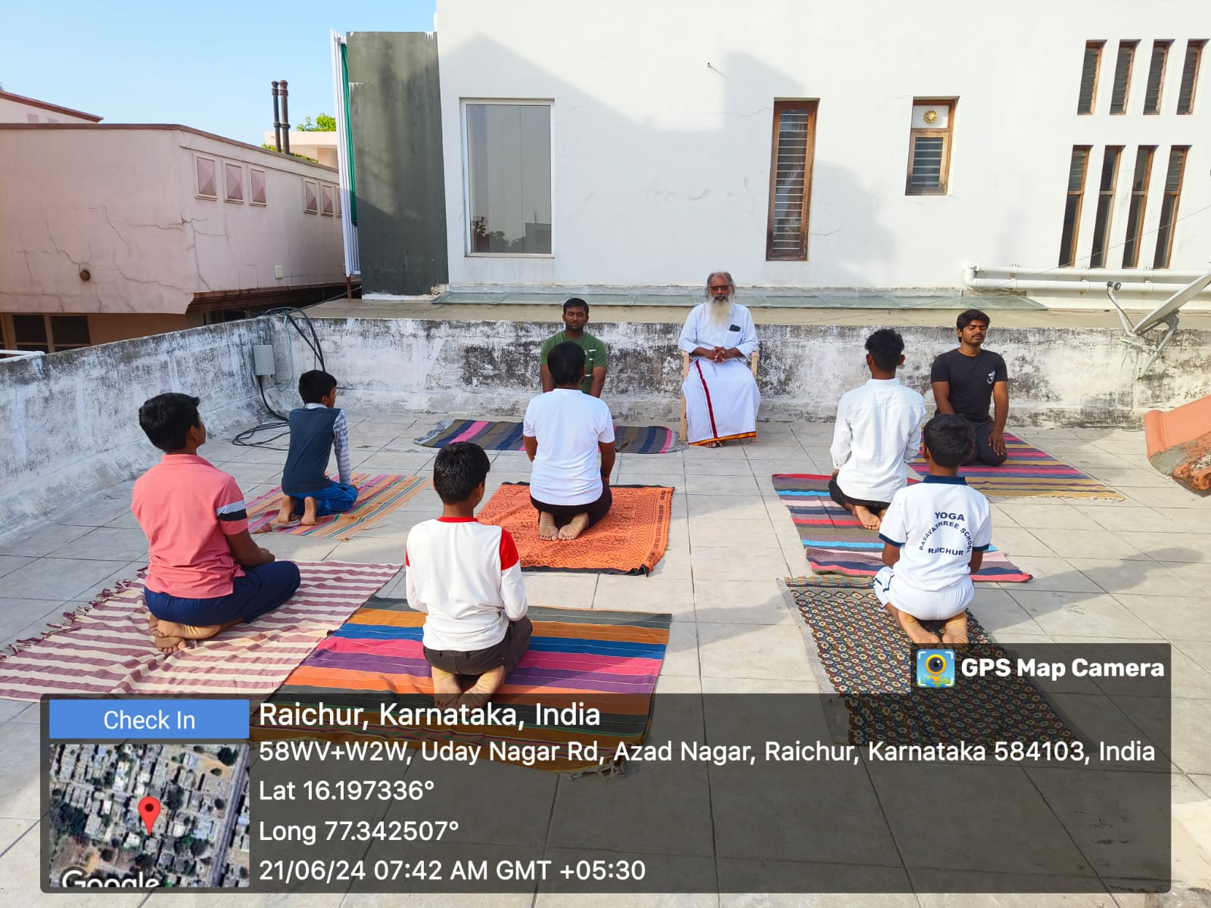

Slide 20
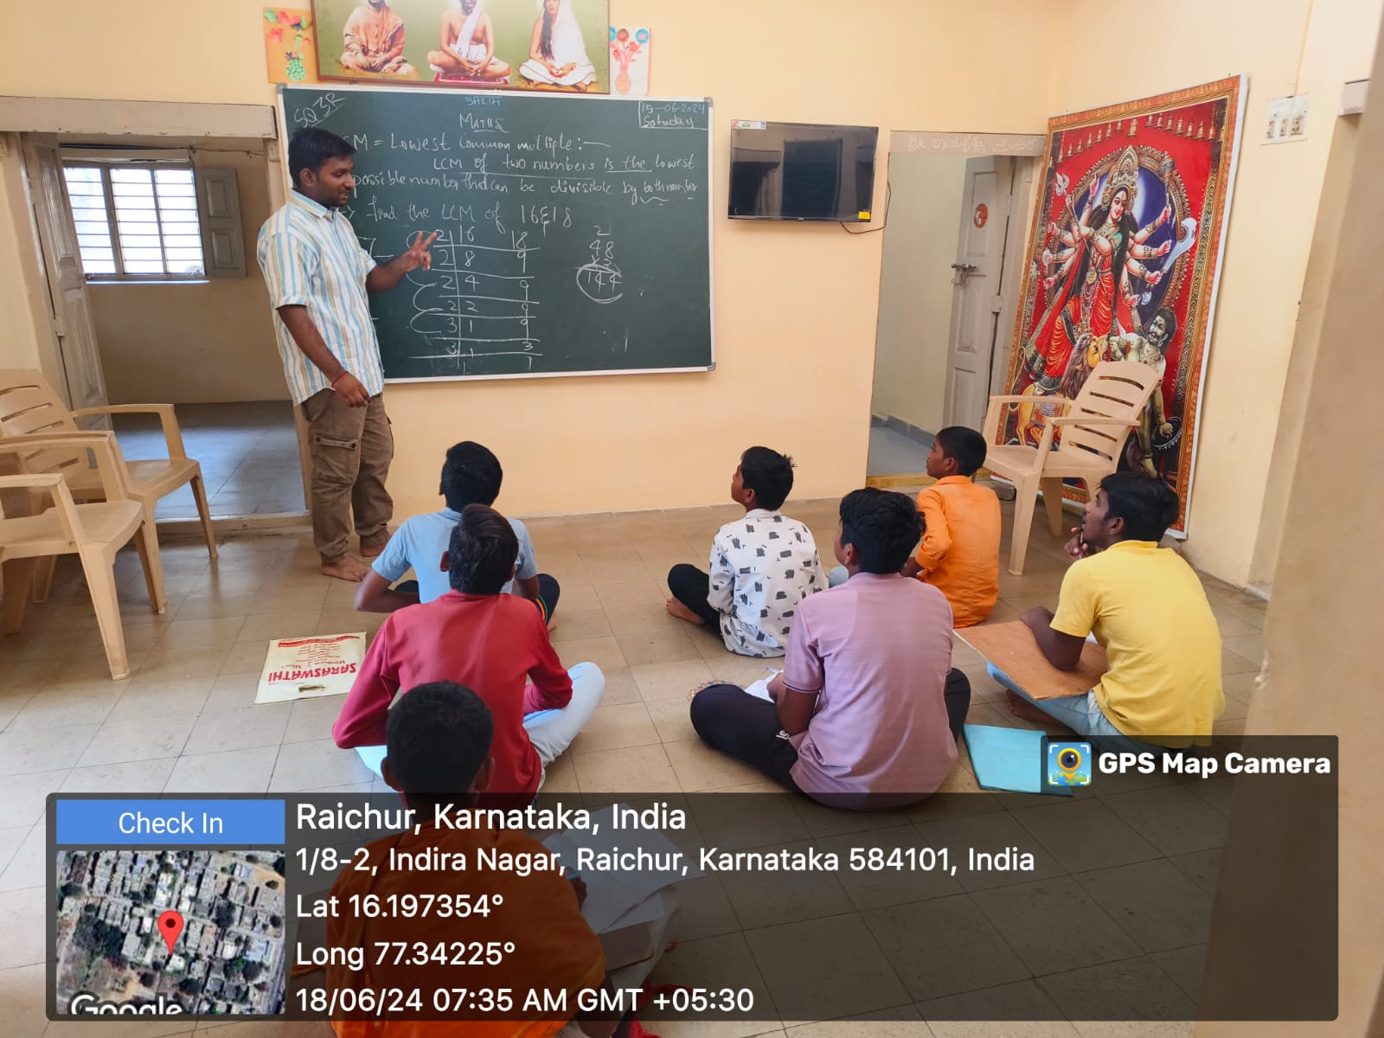

Slide 21
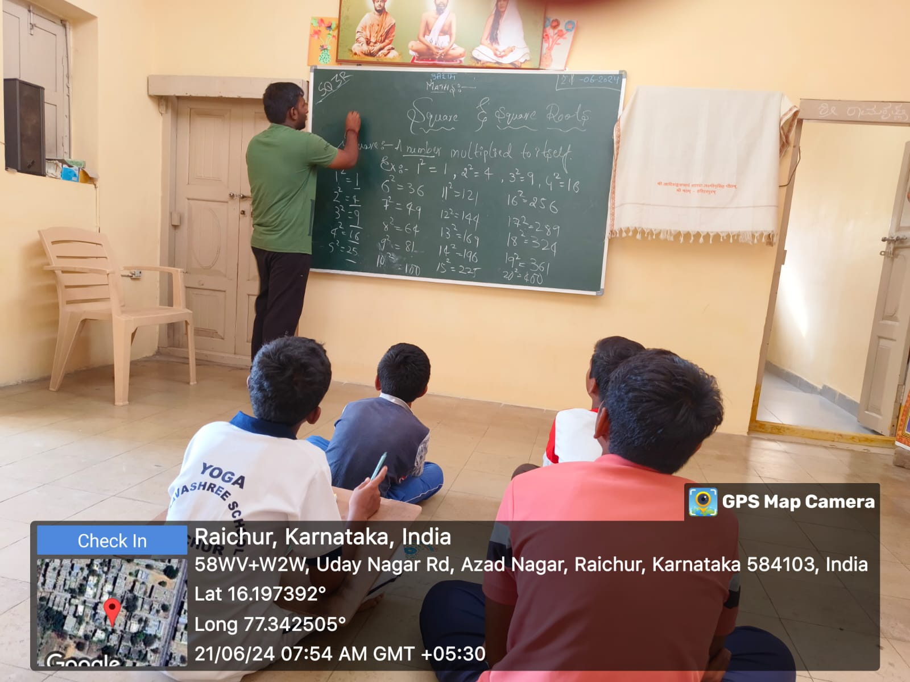

Slide 22
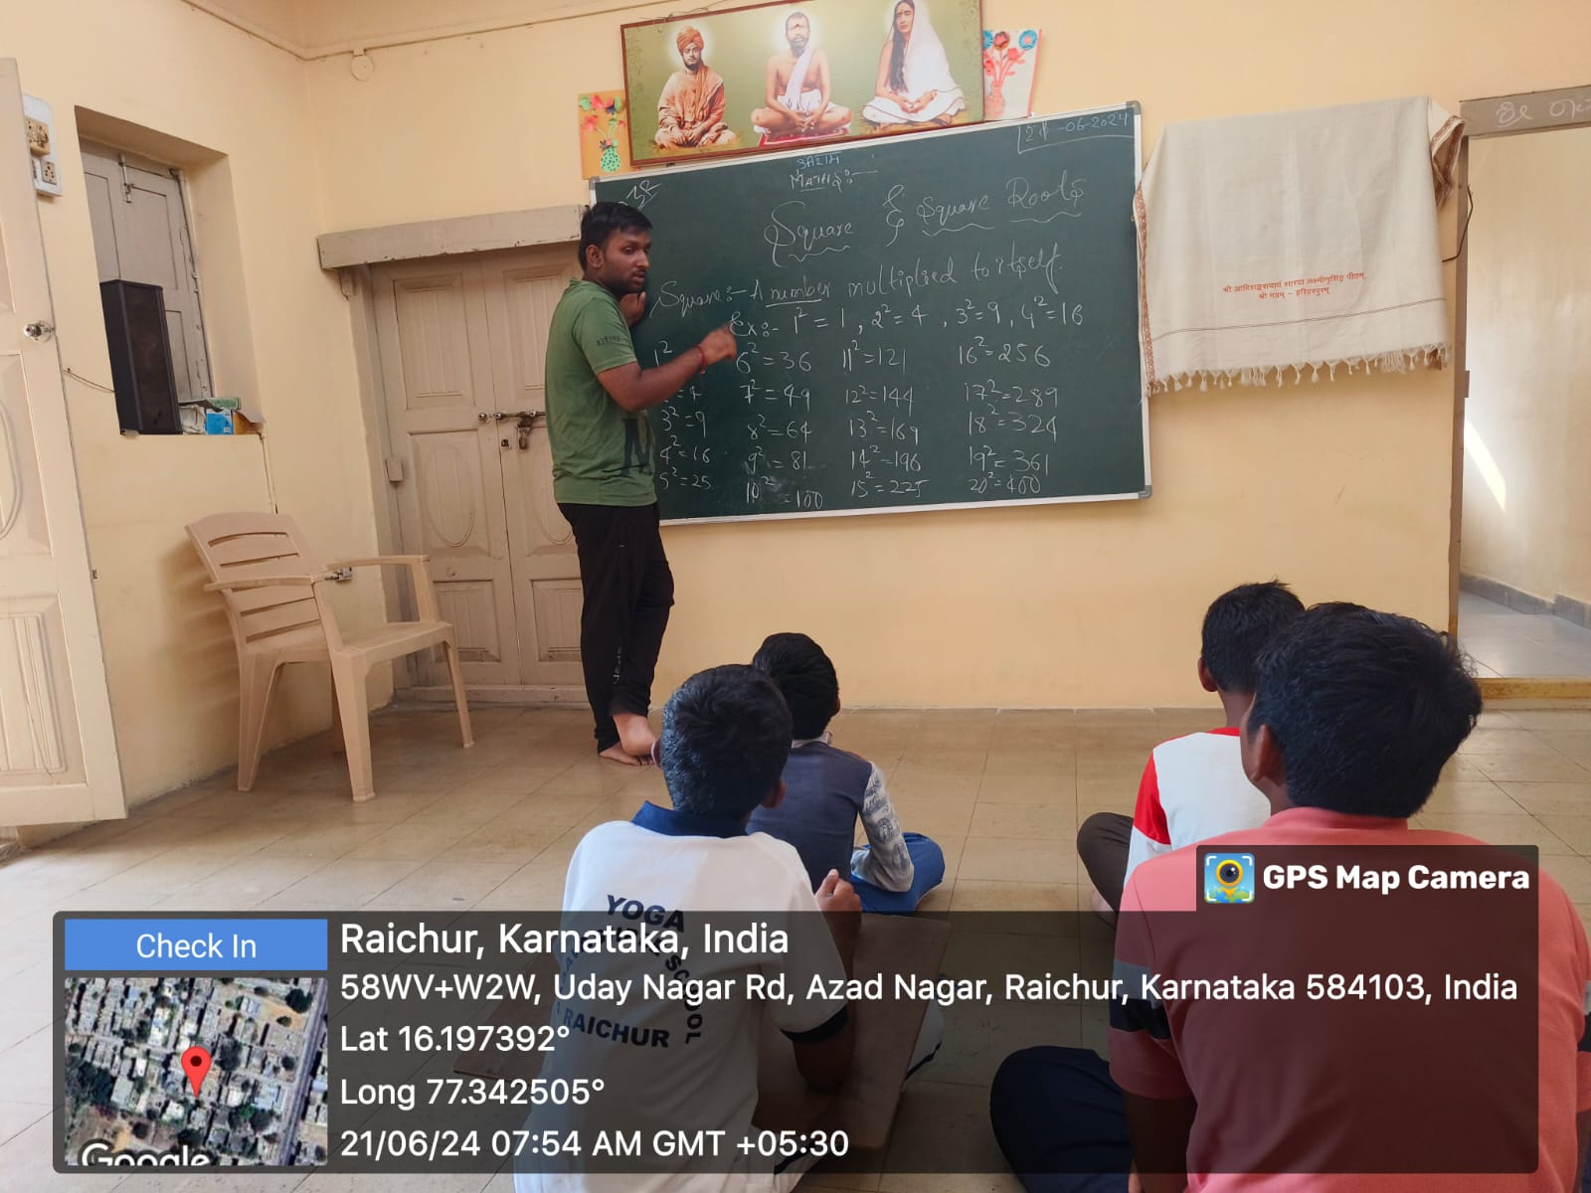

Slide 23
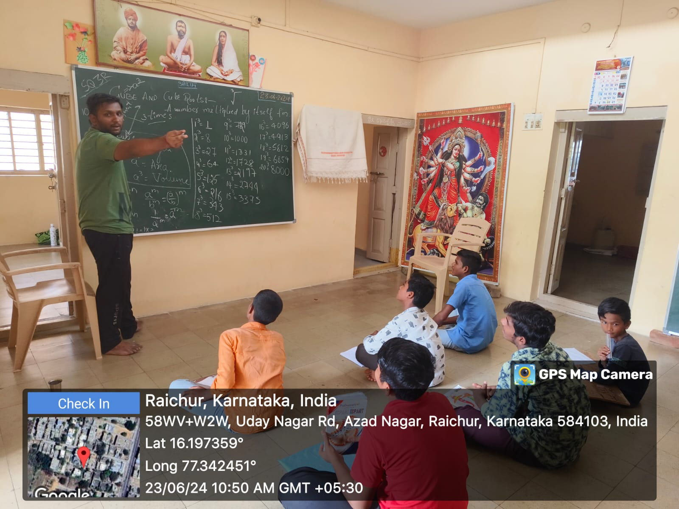

Slide 24
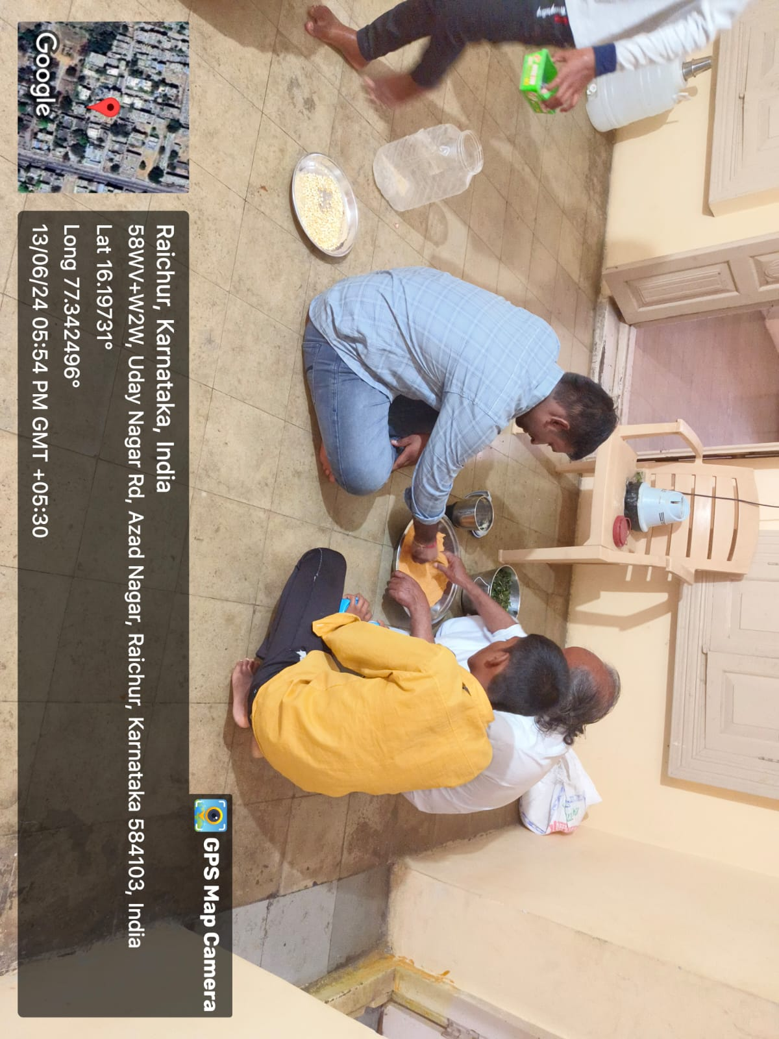

Slide 25
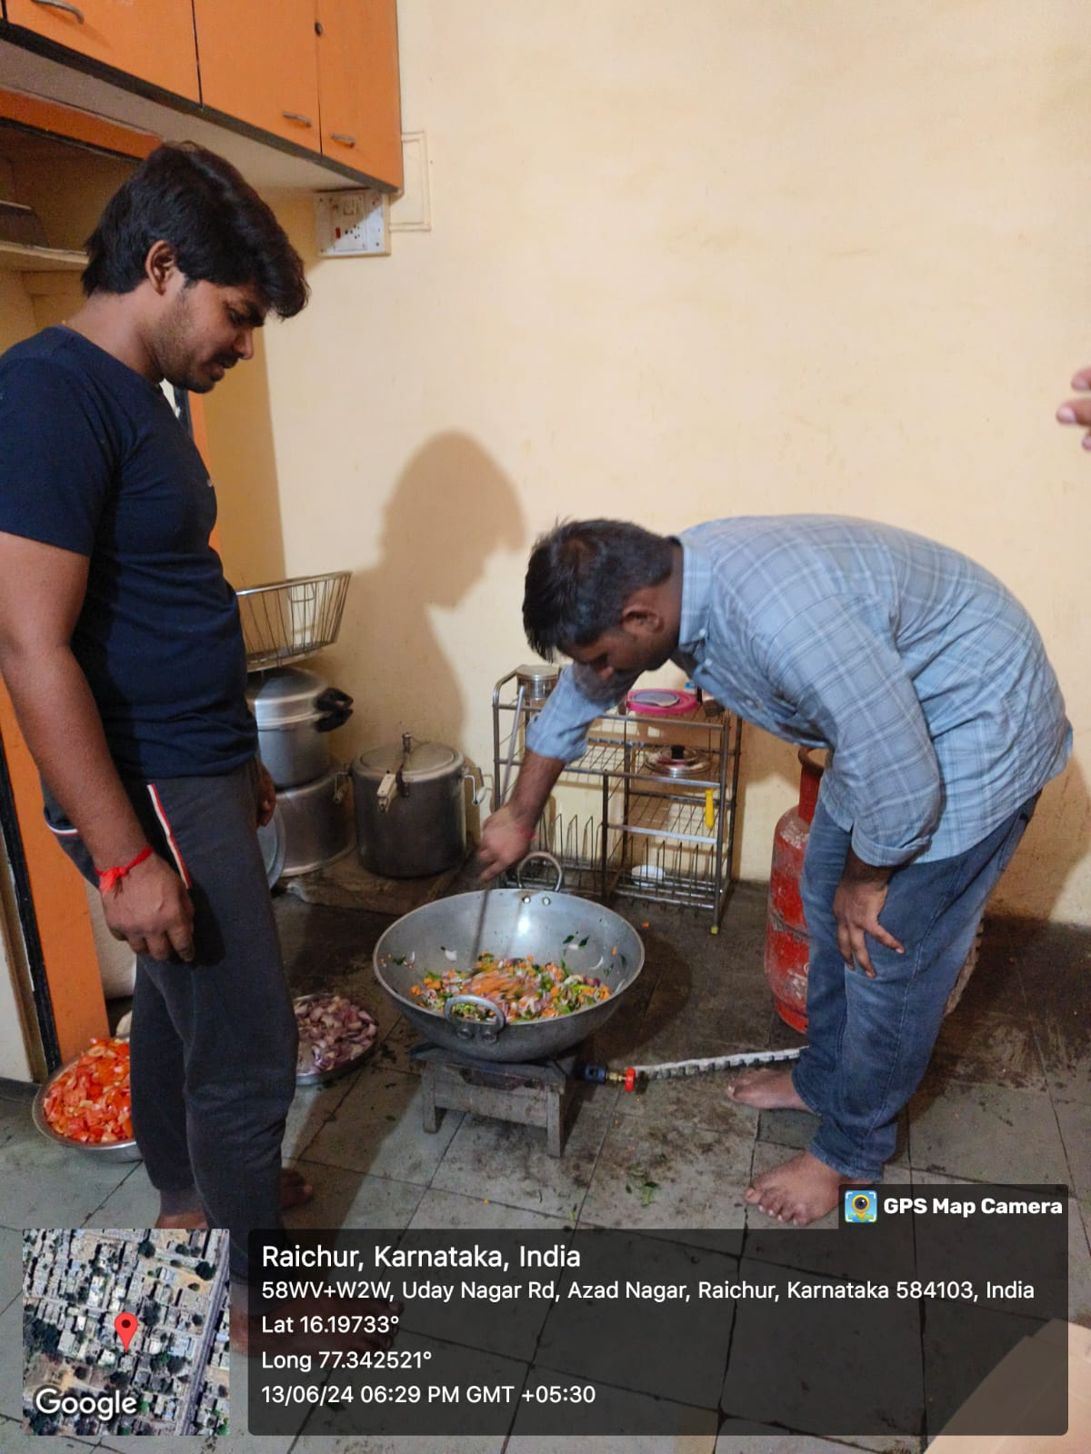

Slide 26
Identified societal problems Lack of Awareness About Child Rights: Need to educate both children and adults about their rights. Ensuring children are seen as individuals with rights. Limited Access to Quality Education: Barriers due to socioeconomic factors and inadequate infrastructure. Illiteracy Among Women: Deep-rooted perception of women's roles. Necessity of recognizing women's equal potential and contributions.

Slide 27
Conclusion Project Impact: Enhanced educational opportunities and raised awareness about child rights. Addressed educational gaps and socio-cultural barriers. Empowered children and community through education and rights awareness. Future Plans: Continue efforts, expand reach, and explore additional support methods. Create a more educated, aware, and empowered future generation.

Slide 28
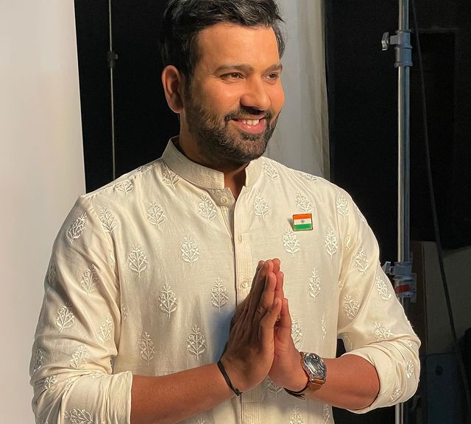
Thank you
"Every child is a different kind of flower, and all together, make this world a beautiful garden."

